Slide 1

Mental Organs and the
Breadth & Depth of Consciousness

Slide 2
The Human Mind
Most Complex Known Entity
Great Frontier of Science

Slide 3
Neuroscience
&
Subjective Experience
cultural problem
disarmed
the mind isn’t objective & doesn’t always look scientific
to describe it as it is, and talk about feelings or the sense of self, may not sound like science
It may sound more like humanities

Slide 4

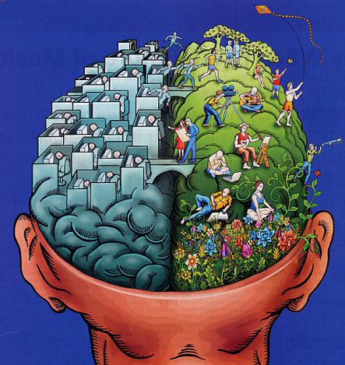

Natural History

Slide 5
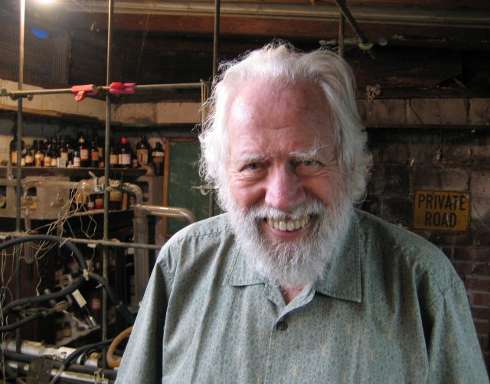
Shulgin Pioneered the Method
Mescaline sulfate 400 mg: “The most compelling insight of that day was that this awesome recall had been brought about by a fraction of a gram of a white solid, but that in no way whatsoever could it be argued that these memories had been contained within the white solid. Everything I had recognized came from the depths of my memory and my psyche... there are chemicals that can catalyze its availability.”
- Sasha (Shulgin & Shulgin 1991) p. 16-17

Slide 6
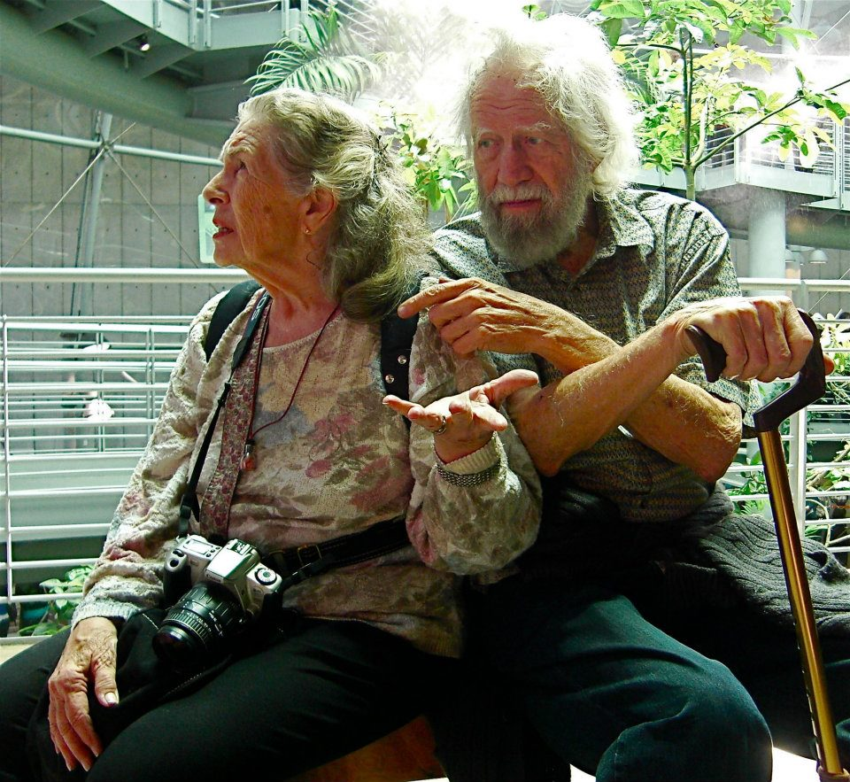
Shulgin Discovered Breadth
“I realized that mescaline no more produced beauty than TMA produced anger. Just as the beauty was always within me, so was the anger. Different drugs may sometimes open different doors in a person, but all of those doors lead out of the same unconscious.” – Sasha (Shulgin & Shulgin 1991), p. 24
“The doors opened by DMT tend to be quite different than those opened by mescaline, for instance, but once you are through those doors, what you encounter is part of yourself”
– Ann (Shulgin & Shulgin 1997), p. 166

Slide 7
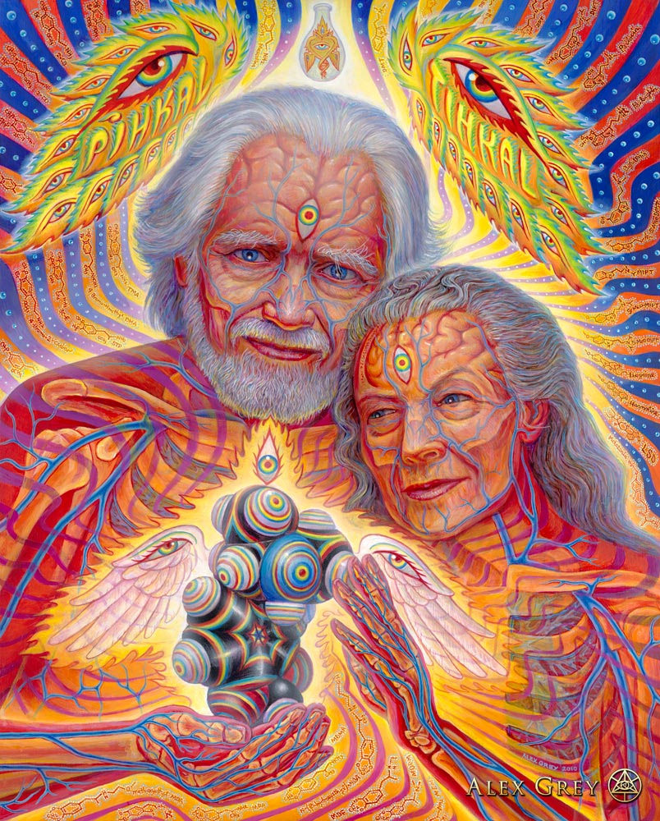
Shulgin Created the Study of Breadth of Consciousness
his toolkit exposed breadth
drug / mental organ diversity
Sasha was on to something
The discovery of our fleeting humanity
Mental Organs
and the Breadth & Depth of Consciousness

Slide 8
Shulgin
“I’m looking for tools that can be used for studying the mind, and other people then will use the tools in finding out the aspects of the mental process and how it ties to the brain.”
Sasha 1996
Drug
Mind
Sala, L. (2007). Alexander Shulgin: why I discover psychedelic substances. Available via https://www.youtube.com/watch?v=QD260LPqHKA

Slide 9
Shulgin
“I’m looking for tools that can be used for studying the mind, and other people then will use the tools in finding out the aspects of the mental process and how it ties to the brain.”
Sasha 1996
Drug
Mind
Drug
Brain
Mind
Sala, L. (2007). Alexander Shulgin: why I discover psychedelic substances. Available via https://www.youtube.com/watch?v=QD260LPqHKA

Slide 10
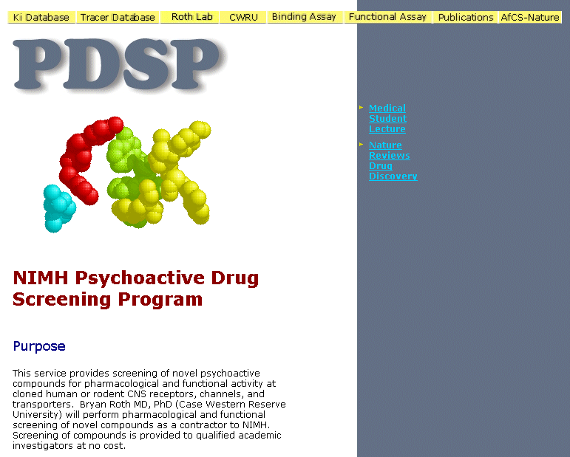
Psychoactive Drug Screening Program

Slide 11
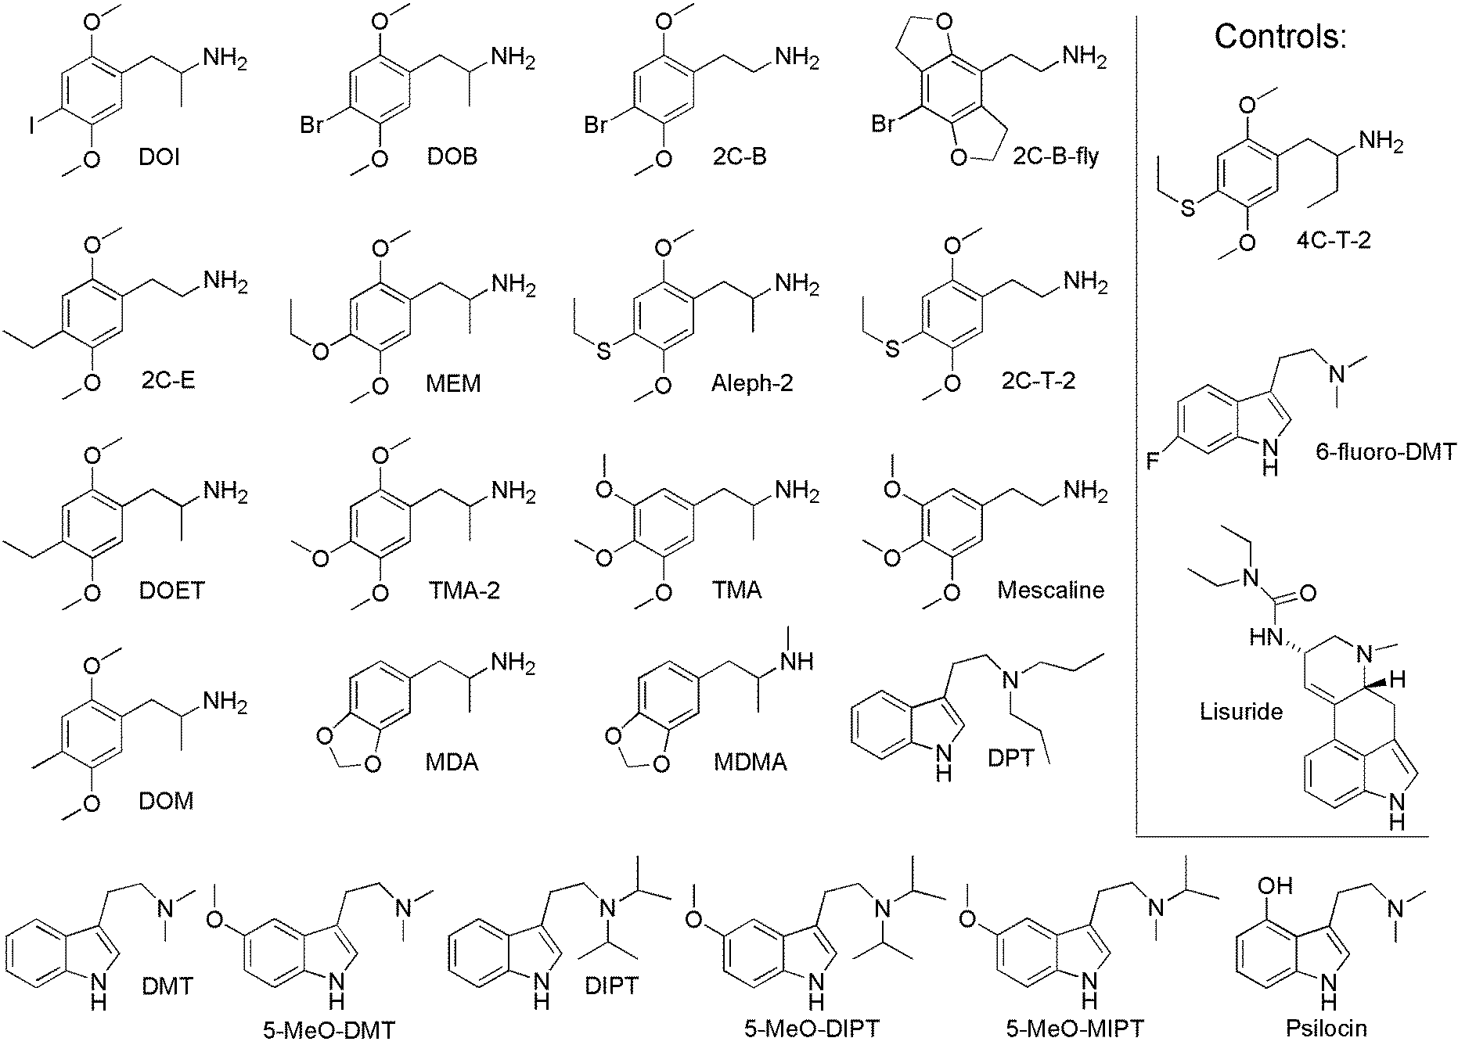
Selected 2002 by Ray, Shulgin, Nichols

Slide 12
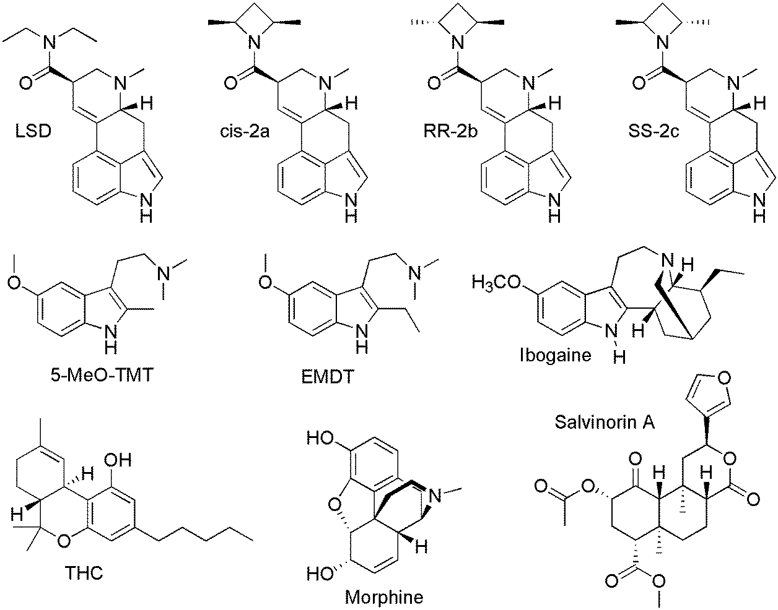

Slide 14
Synthesis of Molecular Affinity Data & Human Natural History
Human Natural History
2C-T-7, 20 mg:
“Suddenly I am completely pierced, down to the core of my being, by what feels like the penetration of the Finger of God. It seems to be a female source that reaches me and touches. I am totally undone by this deep touching, and sob uncontrollably for several minutes, crying out all my pain and fears, and feeling sheer ecstasy. As I feel gratitude for the beauty, I am pierced again and again, and continue to sob.
“What has happened is a once-in-a-lifetime event, a touch of God that is worth dying for. It seems as though it will stand forever and ever. I feel totally changed”
(Shulgin & Shulgin 1991, p. 415).

Slide 15
No Prior Knowledge of Receptors Needed
Human Natural History
2C-T-7, 20 mg:
“Suddenly I am completely pierced, down to the core of my being, by what feels like the penetration of the Finger of God. It seems to be a female source that reaches me and touches. I am totally undone by this deep touching, and sob uncontrollably for several minutes, crying out all my pain and fears, and feeling sheer ecstasy. As I feel gratitude for the beauty, I am pierced again and again, and continue to sob.
“What has happened is a once-in-a-lifetime event, a touch of God that is worth dying for. It seems as though it will stand forever and ever. I feel totally changed”
(Shulgin & Shulgin 1991, p. 415).

Slide 16
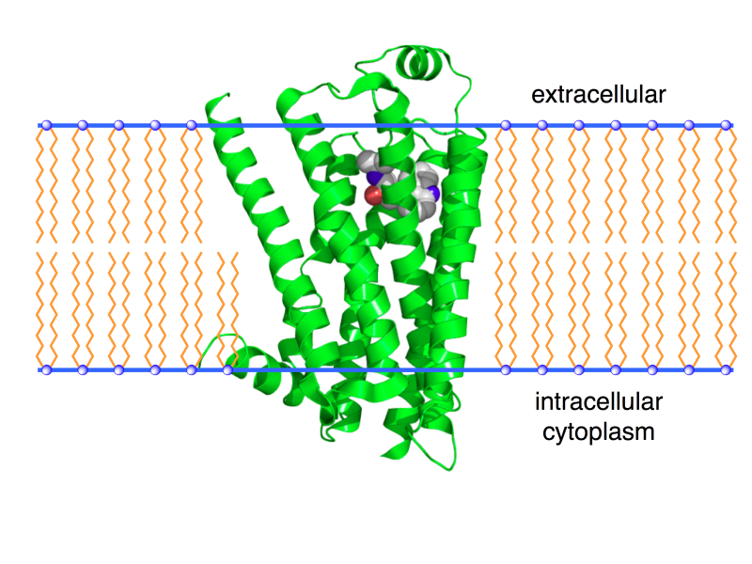
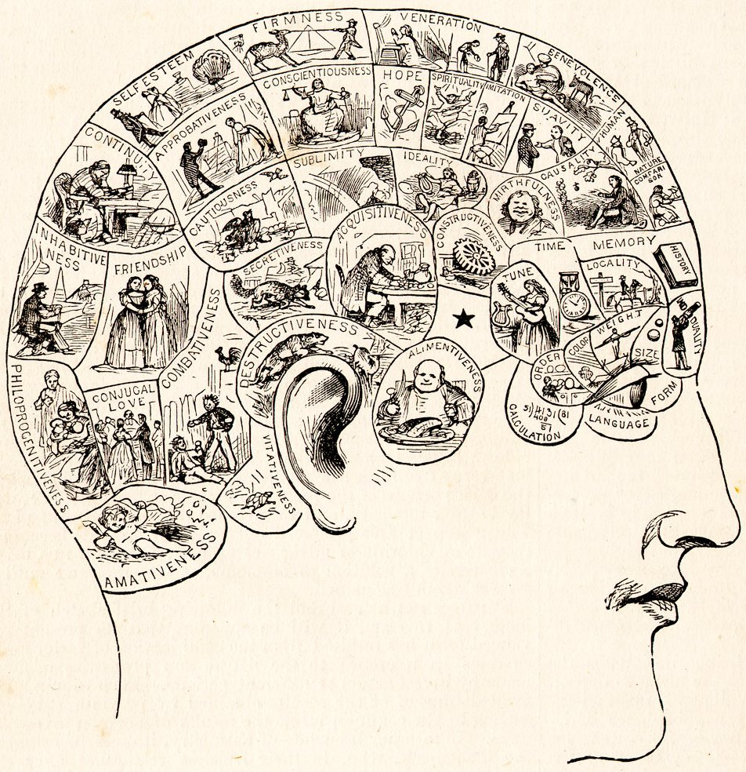
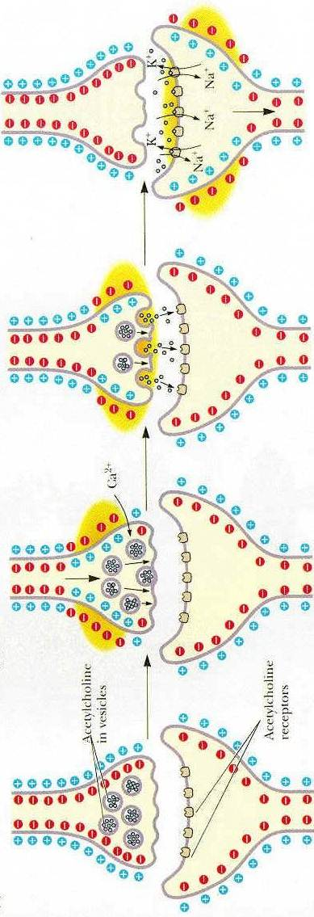
Mental Organs

Slide 17
Mental Organs
Populations of neurons expressing specific modulatory receptors, e.g. 5-HT_{2A}, D₂, σ₁
  Tuned to a specific mental function
  Potentially one for each of >300 modulatory receptor types expressed in human brain
  Don’t know if every modulatory receptor defines a mental organ

Slide 18
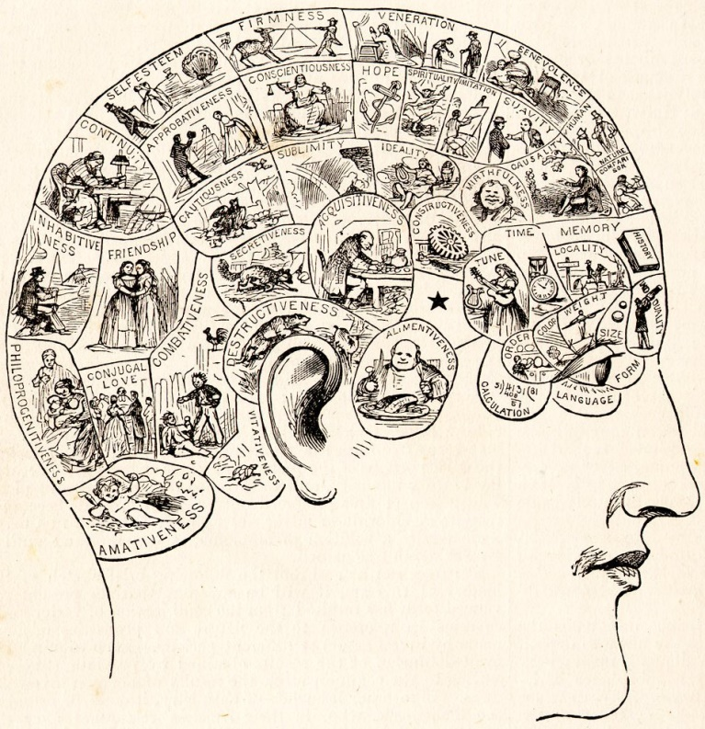
Topology
Topology has not been mapped
Not defined by contiguous 3D volumes
Mental organs are woven together
May join into a unit, samples of neurons from different brain regions & circuit types (e.g., cortex, limbic)
Not!

Slide 19
Mental Organs & Receptors
Receptors define mental organs
“Receptor” & “Mental Organ” somewhat interchangeable
  Receptor – the molecular level
  Mental Organ – the mental level

Slide 21
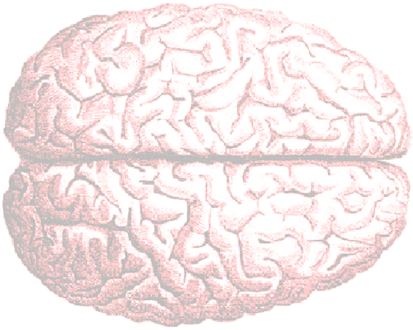
Depth – Consciousness Itself – Serotonin-7
5-HT₇

Slide 22
Depth – Consciousness Itself – Serotonin-7

Slide 23
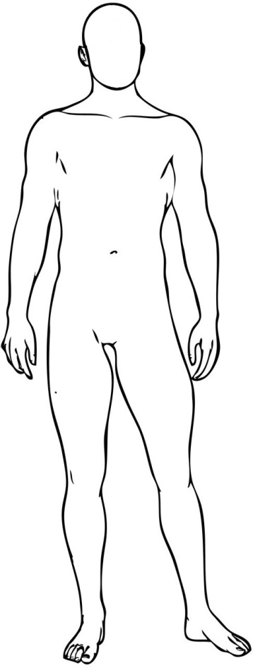
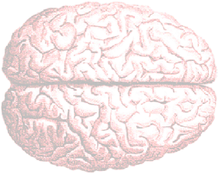
Depth – Consciousness Itself – Resting

Slide 24
Depth – Consciousness Itself – Expanded

Slide 25
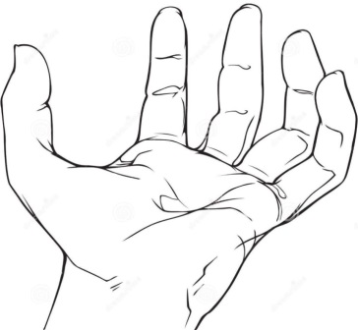
Breadth – Contents: D, H, I, σ, α
σ
α
I
H
D

Slide 26
Breadth – Contents: I
I

Slide 27
Perceptible Affinity

Slide 28
Perceptible Affinity

Slide 29
Perceptible Affinity
2.13
2.15

Slide 30
Perceptible Breadth

Slide 31

Flavor of a Drug
The flavor of a drug is dominated by the mental effect of its best-hit receptor, with that flavor being blended with the mental effects of the successively less strongly activated receptors, to produce a perceptual whole, much like the way odorants and tasteants produce the perceptual whole of flavor out of their pattern of interaction with odor and taste receptors.
paprika, oregano, basil

Slide 32
Flavor of a Drug
Serotonin is not flavor
Serotonin receptors provide the
  mechanisms of consciousness
  not the contents
Serotonin-1 and serotonin-2 do not produce obvious flavors
Serotonin-7 produces the most psychedelic effect
  Flavor enhancer
    Takes flavor to another level
basil, oregano, paprika

Slide 33
Flavor of a Drug
Dominant Flavor

Slide 34
Receptor Breadth

Slide 35
Breadth
17
18
19
4
2

Slide 36
5-HT₂ = Serotonin-2
Became paradigmatic psychedelic receptor
  Over thirty years ago
  during a period in which prohibition led to the study of psychedelic drugs in rodents
  when most of the drugs of this study had not been invented
  when an adequate body of subjective human data on diverse psychedelics could not be assembled
  when our knowledge of neurotransmitter diversity was dramatically incomplete (only 2 of 14 5-HT known)
  when reliable affinity screening at a broad panel of receptors was not possible
  a decade before 5-HT₇ was discovered
Premature convergence on 5-HT₂

Slide 37
Drug Breadth

Slide 38
Drug Breadth

Slide 39
13 Characterized Mental Organs
Conscious mental space
  Serotonin-7 – Adult, modern, cognitive and affective consciousness
  κ – Childhood (and likely pre-human), only affective consciousness
Management of access to consciousness
  Serotonin-2 – Dynamic, moment-to-moment
  Cannabinoid-1 – Long-term, progressive, cumulative, semi-permanent selective blocks
Contents of consciousness
  Cognitive
    Serotonin-1 – Language, logic, reason, concepts, thought, patterns in nature
  Affective
    β – Home, family, community, society, humanity, joy
    Histamine-1 – Empathy; dynamic, persistent, and cumulative theory of mind
    α₂ – Sense of the essence or soul of things (rasa), or events shaping one’s self
    α₁ – Sense of continuity, history, flow of events
    Dopamine – Meaning, significance, awe, and certainty; integration
    Imidazoline – Ecstasy, empathy, openness, compassion, peace, acceptance, forgiveness, healing, oneness, caring; letting go of anger, grudge, guilt, shame, anxiety; ability to safely experience and contemplate mental pain
    μ – Comfort, security, peace, gentleness; dissipation of pain, hunger, tension, anxiety, frustration, fear, anger and aggression; Edenic
σ – Core of our being, our heart & soul; purely affective

Slide 40
No Prior Knowledge of Receptors Needed
Conscious mental space
  Serotonin-7 – Adult, modern, cognitive and affective consciousness
  κ – Childhood (and likely pre-human), only affective consciousness
Management of access to consciousness
  Serotonin-2 – Dynamic, moment-to-moment
  Cannabinoid-1 – Long-term, progressive, cumulative, semi-permanent selective blocks
Contents of consciousness
  Cognitive
    Serotonin-1 – Language, logic, reason, concepts, thought, patterns in nature
  Affective
    β – Home, family, community, society, humanity, joy
    Histamine-1 – Empathy; dynamic, persistent, and cumulative theory of mind
    α₂ – Sense of the essence or soul of things (rasa), or events shaping one’s self
    α₁ – Sense of continuity, history, flow of events
    Dopamine – Meaning, significance, awe, and certainty; integration
    Imidazoline – Ecstasy, empathy, openness, compassion, peace, acceptance, forgiveness, healing, oneness, caring; letting go of anger, grudge, guilt, shame, anxiety; ability to safely experience and contemplate mental pain
    μ – Comfort, security, peace, gentleness; dissipation of pain, hunger, tension, anxiety, frustration, fear, anger and aggression; Edenic
σ – Core of our being, our heart & soul; purely affective

Slide 41
Categories of Mental Organs
Cognitive – language, logic, reason
Affective – feelings & emotions

Slide 42
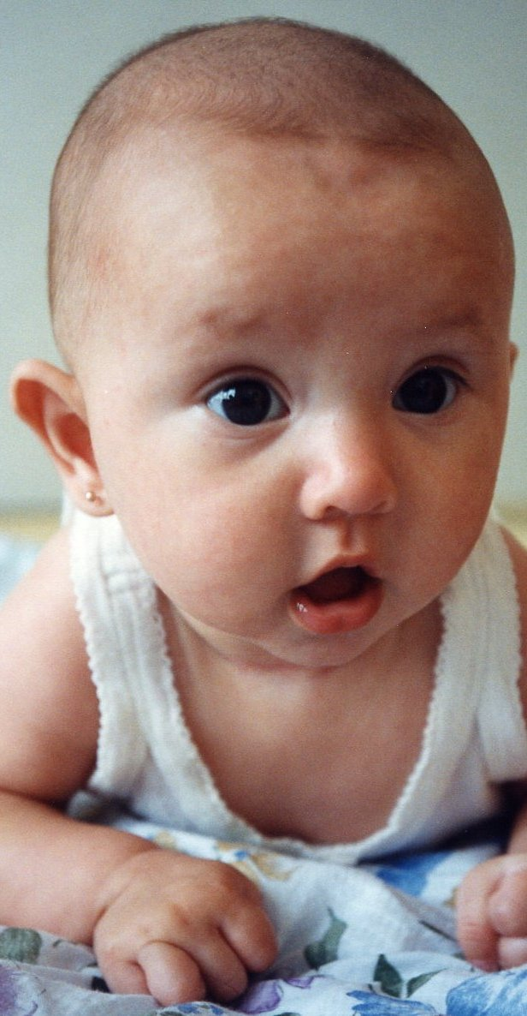
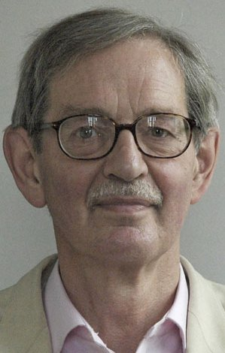
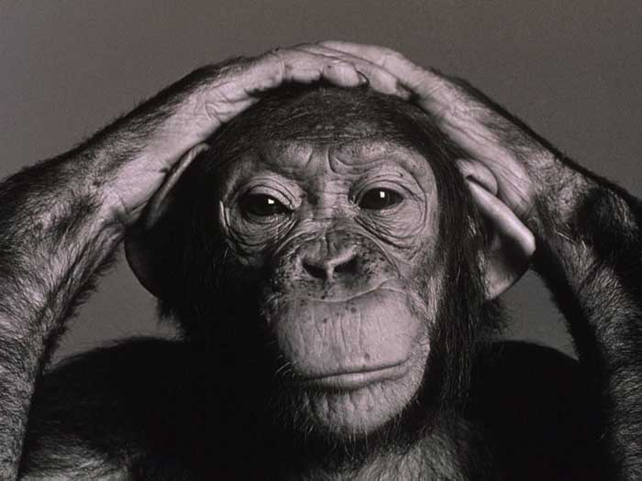
Cognitive & Affective
Affective
cognitive & affective
reason & feeling
head & heart
modern & archaic
adult & child
human & animal
Affective
Cognitive

Slide 43
Cognitive & Affective
Affective
cognitive & affective
reason & feeling
head & heart
modern & archaic
adult & child
human & animal
Affective
Cognitive
Our minds shift from affective to cognitive
  As we evolve from animals into modern humans
  As we grow from infants into adults

Slide 44
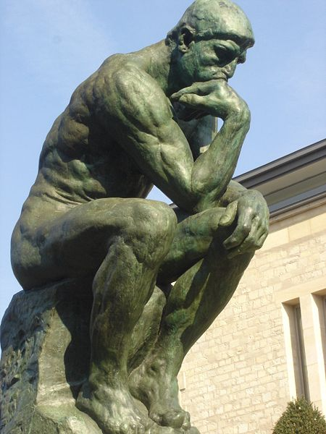
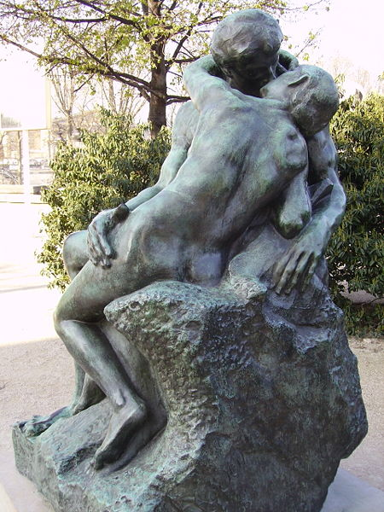
Cognitive & Affective
“The Thinker” (left), and “The Kiss” (right), both by sculptor Auguste Rodin

Slide 45
Cognitive & Affective

Slide 46
Kappa & Serotonin-7 – Consciousness
Kappa – Modern human childhood & archaic
  Affective only (no cognition)
  All heart, no head
  Salvia: “I felt like I was eight years old, in a park around my house in a swing during the middle of a summer day. (note, I didn’t see any of this, it was purely a feeling)”
Serotonin-7 – Modern adult human
  Backward compatible: cognitive & affective
  Head and heart

Slide 47

A Language Older Than Words
Feelings are the original language of description of our world
  for internal representation in consciousness
  but were ineffable
Words – the origin of cognition
  emerged to communicate feelings
  crystalized around a preexisting affective language

Slide 48
Thought-Free Awareness
Ducks & Tornado – story
Infant & Outlet – parable
Arthur, J. D. (2010). Salvia Divinorum: Doorway to Thought-Free Awareness. Park Street Press.

Slide 49
Beauty as a Feeling
Mescaline sulfate 400 mg: “for the first time in my life I knew what the word “beauty” meant. True, I had spoken of it thousands of times before, had pointed at objects I’d been taught to believe were beautiful and said the word in association with them, and had occasionally had vague, moderately positive feelings in connection with such objects. Now I understand that I had never even begun to penetrate what beauty was all about. … the incredible and intense immediate experience of beauty…” (Tart 1983) p. 226.
  Modern: beauty is a noun
  Archaic: beauty is a feeling
Feelings: beauty, home, elegance, majesty, adventure

Slide 50
Flavor

Slide 51
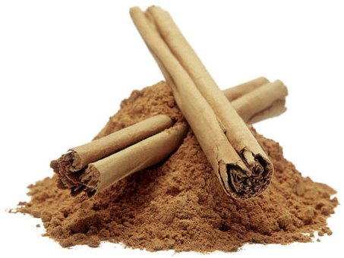


Slide 52

Categories of Mental Organs
Cognitive – language, logic, reason
Affective – feelings & emotions

Slide 53
Categories of Mental Organs
Many content mental organs – breadth
Mechanisms of consciousness
  Hands of the mind – shape breadth
  Mental space – depth

Slide 54
Categories of Mental Organs
Many content mental organs – breadth
Mechanisms of consciousness
  Hands of the mind – shape breadth
  Mental space – depth

Slide 55
Ways of Knowing
Each content mental organ
  paints a different facet of reality in consciousness
  can be in or out of consciousness
More content mental organs in consciousness means
  greater breadth
  a representation of reality that is
    more multi-faceted
    more complete

Slide 56
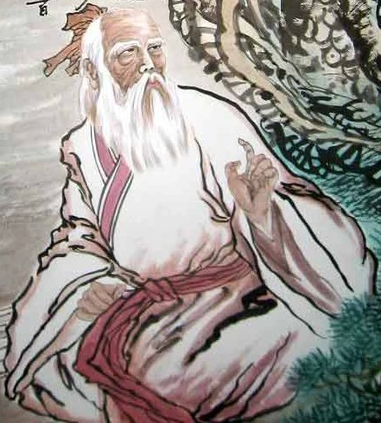
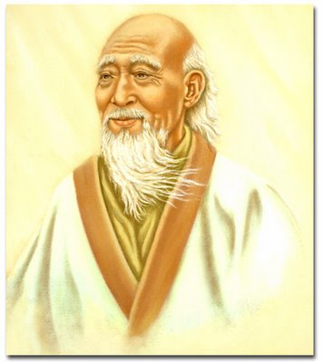

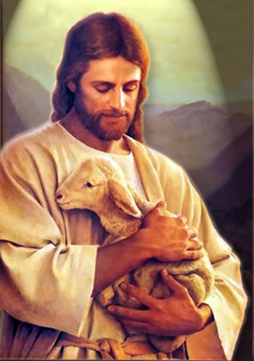


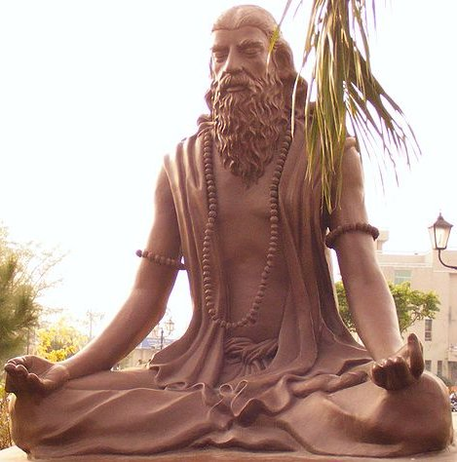
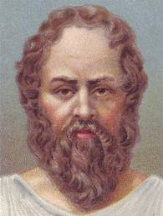
Lao-Tzu (Tao):
Beta & Alpha-2
Shinto: Alpha-2
Confucius: Beta
Jesus:
Imidazoline & Dopamine
Patanjali (Yoga): Sigma
Siddhartha Gautama:
Serotonin-7
Socrates: Serotonin-1

Slide 57
Cognitive Mental Organ
Language, Logic, Reason

Slide 58
Serotonin-1 – Cognition
Socrates taught how to think rationally, at a time when it wasn’t done, and is credited with the origin of the “concept”.
From Socrates and others, ultimately flowed the age of reason and the age of enlightenment.
Socrates
469 BC – 399 BC
Serotonin-1

Slide 59
Serotonin-1 – Cognition
“DOET produced a marked decrease in the proportion of high frequency associations… The decline in high frequency associations… was related to an increase in low and medium strength association, with no increase in idiosyncratic associations… The DOET subjects produced less common, but not bizarre, associations.”
Snyder, S. H., Faillace, L. A. & Weingartner, H. (1968b). DOM (STP), a new hallucinogenic drug, and DOET: effects in normal subjects. The American Journal of Psychiatry, 125, 113-120.

Slide 60
Serotonin-1 – Cognition
“… DOET… has been found by several research groups to facilitate the unblocking of imagination and creativity.”
(Shulgin 1983). p. 208
DOET 2 mg: “I worked on some problems in my software. A certain problem had been plaguing me for the last two days. I had been putting in patches all over the place to fix the problem. Now I stumbled onto an elegant solution which made the problem evaporate. I replaced two pages of code with five elegant lines, and I was able to go back and pull out all the patches.”
(Shulgin 2016) Pharm 1, p. 13

Slide 61
Serotonin-1 – Cognition
DOET 4 mg: “I wrote an article for a magazine who wanted a popularization of my work with a personal touch. Wow, am I glad I tried! The words poured out, rather nicely. I really like the way I wrote with it. I felt that it was a voice I hadn’t used before, and I liked it. I was so free and playful with the words. I think I was able to write it just the way the editor asked me to. Eventually, the article was published, and subsequently translated into several languages and re-published in many places. I think this could be a very valuable material for a writer, and perhaps in other circumstances requiring creative work as well.
“The next time I sat down to write, without using any drug, much to my surprise, what came out was of the same style and quality that I first developed with DOET, and flowed with the same ease as did writing under the influence. It appears that with my first DOET experience, I found a new writing voice, one that I feel very comfortable with, and which I have retained. I would describe this new style as more simple and straight-forward, less jargonesque, and more honest and enthusiastic.” (Shulgin 2016) Pharm 1, p. 13

Slide 62
Serotonin-1&2 – Subtle & Transparent
DOET 4 mg: “DOET is really strange. A tiny dose has a distinct effect, which is largely unmistakable due to some sensations in the body. However the mental effects are so subtle as to be virtually non-existent, until I put myself to work. My written verbal ability is clearly enhanced with DOET, but there is little other mental effect that I can clearly put my finger on. I really don’t “feel” any different mentally, on DOET.”
(Shulgin 2016) Pharm 1, p. 13

Slide 63
5-HT₁ & LSD Micro-dosing
Fadiman, J. (2011).
The Psychedelic Explorer's Guide:
Safe, Therapeutic, and Sacred Journeys.
Rochester, Vermont: Park Street Press.

Slide 64
Affective Mental Organs
Numerous
Non-Serotonin

Slide 65
Imidazoline
Ecstasy, empathy, openness, compassion, peace, acceptance, healing, oneness, caring
Forgiveness
  True letting go in one’s heart of
    anger, grudge (forgiving another)
    guilt, shame (forgiving one’s self)
  Can be healing
Ability to safely experience, contemplate, and process mental pain

Slide 66
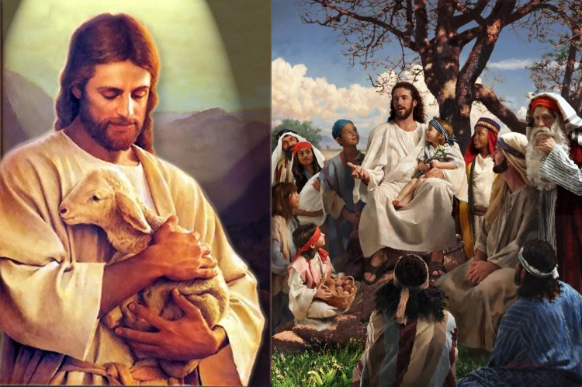
Compassion & Forgiveness
open hearted tenderness, compassion, forgiveness (true letting go in one’s heart of anger, grudge, guilt, or shame), healing, love
Jesus
5 BC/BCE – c. 30 AD/CE
Imidazoline

Slide 67
Beta – Joy
2C-T-7 & 2C-T-21?
French term or phrase: joie de vivre
English translation: exuberance, joy of living, love of life
… joy of conversation, joy of eating, joy of anything one might do. One may speak of a joie de finesse (refinement, grace, elegance), joie de réussite (success), the joy of summer, the joy of an embrace, etc. … – joy of friendship.
http://www.proz.com/kudoz/510884
the sense of happiness, joy, elegance, luxury; the feeling of a fine brandy; the feeling of the season when all the fruits ripen; the feeling of the bustle in the street; coming home to your mother’s arms; the feeling of the smoke from the chimney when dinner is cooking; the joy of cooking.

Slide 68
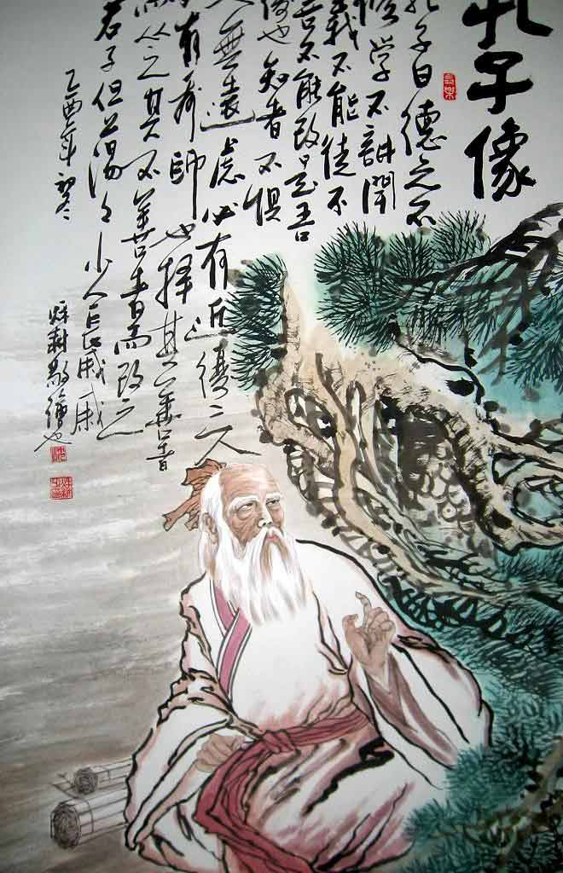
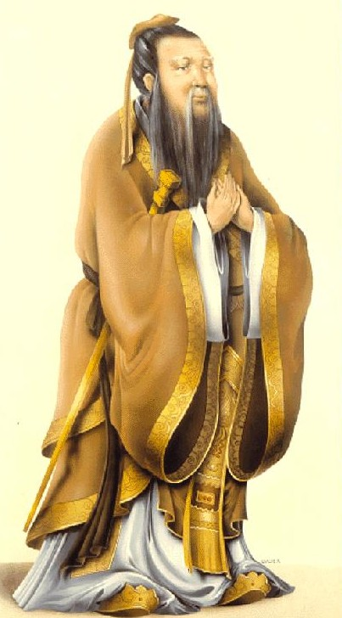
Beta – Home, Family, Humanity
a sense of home,
family,
community,
society,
humanity,
and human nature,
that shows as wisdom
and may provide a moral
compass in human affairs
Confucius
551 BC – 479 BC
Beta

Slide 69

This is a Really Good Perfume
R rated for Aberrant Behavior Involving, Nudity, Violence, Sexuality, and Disturbing Images
2006
http://www.imdb.com/title/tt0396171/

Slide 70
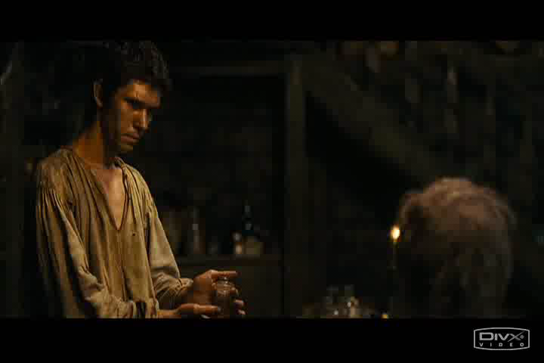

Slide 71
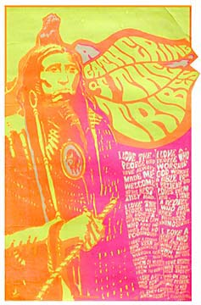
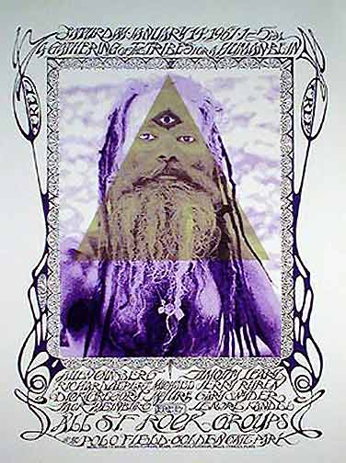

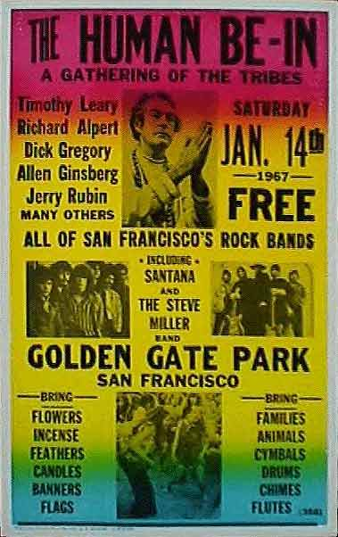
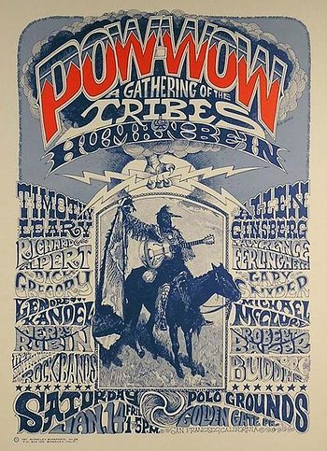
Beta – Dark Side
5,000 tablets in 10 mg dosage

Slide 72
Alpha-2 – Essence – Rasa
Rasa. Sanskrit word “Capturing the very essence, the very spirit of something, in order to evoke a specific mood or emotion in the viewer’s brain”. Vilayanur S. Ramachandran
Mescaline 400mg: “A plain wooden chair was invested with a ‘chairiness’ which no chair ever had for me before.”
“Barbed wire on a fence outside was sharp and bitter, a crown of thorns, man’s eternal cruelty to man. It hurt me.”
(Osmond 1952)

Slide 73

Alpha-2 – Essence – Rasa
Shinto: “There are natural places considered to have an unusually sacred spirit about them, and are objects of worship. They are frequently mountains, trees, unusual rocks, rivers, waterfalls…”
https://en.wikipedia.org/wiki/Shinto

Slide 74

Alpha-2 – Essence – Rasa

Slide 75
Alpha-2 – Essence – Rasa

Slide 76
Alpha-2 – Essence – Rasa
Common Sense About Things
Rocks are hard, solid, durable, and ancient. They are commonly used in the design of Zen gardens because they evoke through our rasa, a sense of timelessness. We get it.
Water is wet, fluid, flowing, refreshing, and necessary for life. We feel it.
Flowers are attractive. They evolved their look and odor to attract pollinators. Attraction is a part of their essential nature, and we get it. We are attracted by their beauty and odor as well.

Slide 77
Alpha-2 – Essence – Rasa In
The alpha-2 mental organ has two facets:
to behold the essential nature of
the world around us: mescaline, DOI
ourselves: MDA, 2C-E
Manifests in MDA and 2C-E as vivid recall or reliving of events that significantly shape one’s life. These could be long forgotten events from early childhood, or recent events of adulthood.

Slide 78
Alpha-2 – Essence – Rasa In
MDA: “in the MDA-elicited state the patient simultaneously regresses and retains awareness of the present self... the person more than conceptually remembers the past, as he may vividly recapture visual or other sensory impressions inaccessible to him in the normal state, and he usually reacts with feelings that are in proportion to the event.” (Naranjo 1973) p. 27

Slide 79
Alpha-2 – Essence – Rasa In
2C-E, 20 mg: “My father, clear, immediate, right there, speaking to me in Russian, reading to me, with his patient voice. I am very little, sitting on his knee. I was not hostile, just arrogant.
“I was a two-year-old child on my father’s lap, being instructed with love in the Russian words that illustrated the alphabet, from a child’s book of Russian letters. I heard my father say the letter, then the word, and I was repeating both while squirming in his lap.
“This was not a memory of being two years old in my father’s lap; this was actually being two years old in his lap. I was looking out of two-year-old eyes at the pages of the book and I could see the colored letters on the paper, in a room which was extremely high and wide and long.” (Shulgin & Shulgin 1991) p. 93-95.

Slide 80
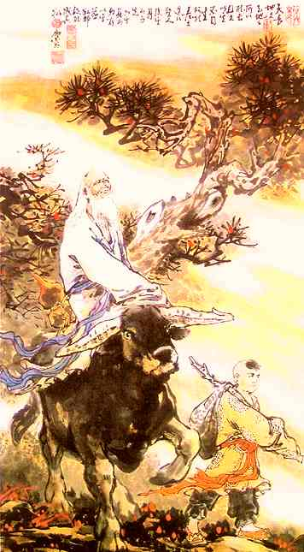
Tao
“the soft and invisible power within all things”. It is a state in which “everything is seen as it is, without preconceptions or illusion”. “It is believed to be the true nature of the mind, unburdened by knowledge or experiences”
Lao-Tzu
6th century BC
Alpha-2 & Beta
http://en.wikipedia.org/wiki/Taoism

Slide 81
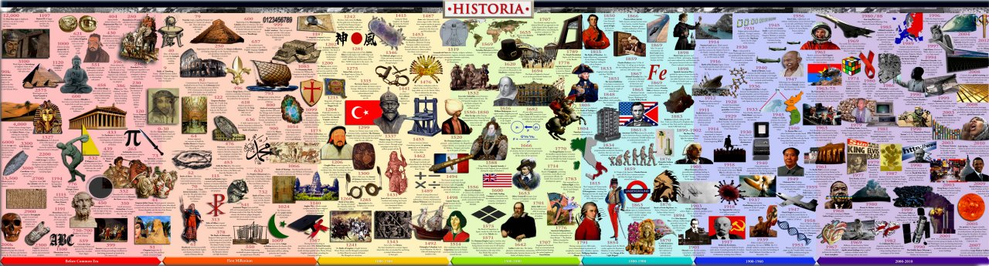
Alpha-1
The sense of the flow of events from the past through the present and into the future. The sense of history. The sense of the unfolding, coherence, continuity, liveliness, and vitality of a scene. The sense that the scene and the entities that populate it extend in space and time, beyond what we directly perceive (it continues behind walls and around corners, from yesterday & into tomorrow). Provides a sense of connection and assurance. Likely fundamental to the emergence of our sense of reality.

Slide 82
Alpha-1

Slide 83
Alpha-1
0.2 mg clonidine and 9.0 mg of 2C-B-fly at noon, cannabis at 3:00 pm:
I found that this state is what makes life worth living. This is what I want out of life. I was not incapacitated in any way, and felt that I could go through life in this state, and would be better for it... I felt that I recognized a sensibility of continuity in my thoughts, e.g. thinking about the changes we go through as we mature from childhood through adolescence into adulthood. I observed: “I believe that I feel a sense of continuity, in that I exist in the moment, and in the time around it. I occupy a greater temporal breadth. This provides a great connection.” I was very present, but not just in the moment.
(Shulgin 2016) Pharm 2, p. 25
Primer/Probe clonidine

Slide 84
Histamine-1
Cumulative Affective Theory of Mind
27 mg of TMA-2: Then I began a journey about how I feel about people. I felt my parents with their very good hearts, my brother with a soft heart but not weak, my sister with a still very innocent heart, and my baby nieces still new and whole. And every grown up has been hurt in some way or another, that their self was shadowed or diminished, or their self was buried in a steel seal of defense (mother-in-law). It’s extraordinary to feel people in this way. There is no judgment, just a feeling associated with the people that comes up to my mind (my family and my husband’s parents and brother), not about wrong or right, just feeling them, and sometimes these feelings so touched me that I was in tears (when I thought of my grandparents). Seeing my family in photos is great. I could feel them. It’s much richer than without the drug…
(Shulgin 2016) Pharm 1, p. 199

Slide 85
Histamine-1
Cumulative Affective Theory of Mind
32 mg of TMA-2: …what seems absolutely unique with this experience is its connection to other people. When I think of my mother, it is as if her presence is with me, in three dimensions. It is not that I see her, actually I see below the surface, her essence is with me. There was a kind of three dimensional representation of her, but it didn’t have the facial surface, it had her inner being. This was very strong when thinking of my mother. I went and reviewed a collection of old family photos, and it was very powerful. I really connected with the souls of my family members.
(Shulgin 2016) Pharm 1, p. 199

Slide 86
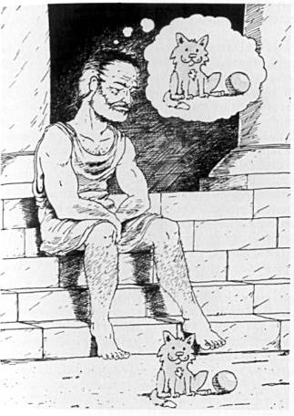
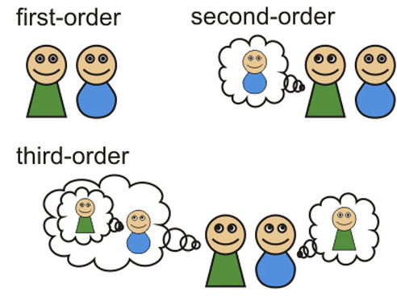
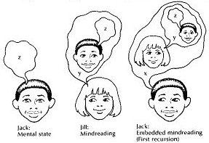
Cumulative Affective Theory of Mind
Histamine-1

Slide 87
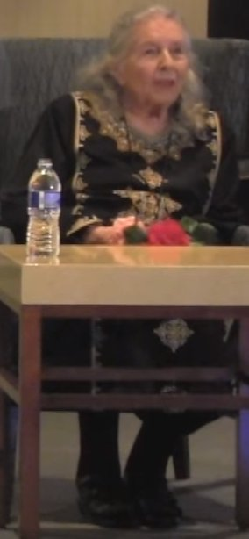
Presence Beyond Death
Q: “My grandparents were married for sixty years until last summer when my grandfather passed away, and for people who have been married for that length of time, in about half of cases, the surviving spouse will experience visions or hallucinations of the deceased spouse. I asked my grandmother if she had experienced this, and she said that she had. I’m wondering if this has happened for you.”
A: “No, I like gutsy questions. Yea. No, I have not seen, but I have not had to grieve very deeply, because any time I want to connect with Sasha, I can. And he is there, more intensely than he was during the time he was alive, or in body, because he doesn’t have the, not personality, but he’s the essence of himself now, and he’s an intensely loving and joyful person, he always was. But he’s even more so now. And so I can call him, I have access to him any time I need to.”
Ann Shulgin: Scientists I Have Known and Loved (Moderated by Tania Manning) Published on May 11, 2017
https://www.youtube.com/watch?v=cxEooEWMIgQ

Slide 88
DMT Entities?
DMT was not assayed at histamine-1

Slide 89
TMA-2 & Sex
27 mg of TMA-2: The sex was wonderful. This was the only sex that has lived up to my imagination about how I should feel in my fantasy sex. This was it. Although psychedelic sex is generally great, with psychedelics it seems that I can not feel the fine details of genital contact which I am able to feel in the normal state without drugs. With this drug I felt the fine detail, and the yearning and desire to be penetrated were very much there and every actual thrust was great and I just wanted more. (Writing and remembering it at this moment makes me want to fuck). During the sex, some imagination came to me, such as we were very young, different kinds of bodies, different skins, that sort of thing. I didn’t feel this imagination interfered with or enhanced sex; it’s neutral, and I wasn’t seeking the imagination at all. It came to me naturally and went along with the rhythm of the action of the moment.
32 mg of TMA-2: …sex was fantastic. When making love, slowly, I was completely in union with my lover. Definitely some of the best sex ever.
(Shulgin 2016) Pharm 1, p. 199

Slide 90
5 Dopamine Receptors
Greatest Strength at Single D Receptor

Slide 91
5 Dopamine Receptors
Greatest Breadth Across 5 D Receptors

Slide 92
Dopamine
Cleanest Presentation of D Receptors
Psilocin: “67% of the volunteers rated the experience … to be either the single most meaningful experience of his or her life or among the top five most meaningful experiences of his or her life … similar, for example, to the birth of a first child or death of a parent. Thirty-three percent of the volunteers rated the … experience as being the single most spiritually significant experience of his or her life, with an additional 38% rating it to be among the top five most spiritually significant experiences.” Griffiths et al. (2006)

Slide 93
Dopamine
Huston Smith was a participant in the original 1962 Good Friday experiment, before writing his textbook
Huston Smith – born 1919
  Religious studies scholar
  Methodist missionary
  Author of “The Religions of Man” revised to “The World’s Religions”
    2 million copies sold
    Common introduction to comparative religion

Slide 94
Dopamine
Psilocin: “The dominant effects of the experience were two: awe (which I had known conceptually as the distinctive religious emotion but had never before experienced so intensely) and certainty. There was no doubting that the Reality I experienced was ultimate. The conviction has remained.” Smith (2001) p. 15.
Huston Smith – born 1919
  Religious studies scholar
  Methodist missionary
  Author of “The Religions of Man” revised to “The World’s Religions”
    2 million copies sold
    Common introduction to comparative religion

Slide 95
Dopamine
Psilocin: “The dominant effects of the experience were two: awe (which I had known conceptually as the distinctive religious emotion but had never before experienced so intensely) and certainty. There was no doubting that the Reality I experienced was ultimate. The conviction has remained.” Smith (2001) p. 15.
Huston Smith – born 1919
  Religious studies scholar
  Methodist missionary
  Author of “The Religions of Man” revised to “The World’s Religions”
    2 million copies sold
    Common introduction to comparative religion

Slide 96
Dopamine
At high doses 5-MeO-DMT becomes D drug
this is god
I am god
all is god

Slide 97
Dopamine
Dopamine can
  combine awe with uncritical certainty
  provoke a religious/spiritual sentiment
  leave deep memory traces
  make us passionate about ideas/ideology
  facilitate the integration of
    a social construct
    a way of life

Slide 98

Awe, Certainty, Meaning, Significance
absolute faith in god, and the immanent end of the world and coming of the kingdom of heaven
Jesus
5 BC/BCE – c. 30 AD/CE
Dopamine

Slide 99

Execution
Debut of Perfume
R rated for Aberrant Behavior Involving, Nudity, Violence, Sexuality, and Disturbing Images
2006
http://www.imdb.com/title/tt0396171/

Slide 100
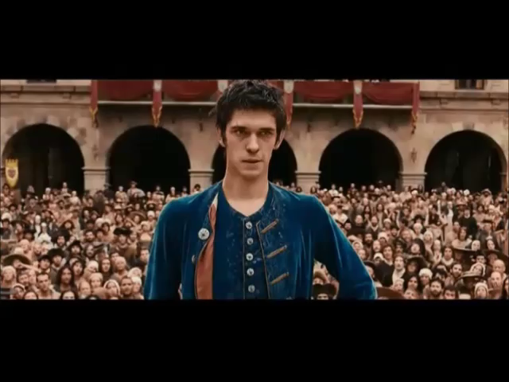

Slide 101
σ – And the Limbic System
The σ receptors effectively define and modulate the limbic system.
Marsh and Zabetian (1992) examined the distribution of σ receptors in the primate brain (rhesus macaque):
“The distribution of sigma receptors in the primate brain suggests that the paralimbic belt cortices, amygdala, hippocampus, hypothalamus, and autonomic relay nuclei of the brainstem may be interrelated by a topographic chemical linkage. The autoradiographic visualization of sigma receptor distributions in the primate brain provides further support for a role of sigma receptor mechanisms in the functions of the limbic system”

Slide 102
Sigma – the Core
σ – The core of our being – the “plant teacher”, “plant intelligence”
The core mental organ around which all others constellate
The primordial mental organ from which all others differentiated & evolved
Biographical memory
Judgment
  genuine or non-genuine
  masks or façades
Primary emotions
  anger/rage, fear, happiness, sadness, surprise, and disgust
Manifests
  integrity, purity, innocence, honesty, uncorrupted
  uncivilized, selfish, hedonistic, emotional (anger/rage…)
Sensitive to pleasure & pain
  needs the protection of the ego
Embedded in the body
  dance, sex
  psychosomatic

Slide 103
Yoga: Mind-Body
Sigma
work through body to free the σ core from the repression of serotonin-2 & cannabinoid
Patanjali
150 BCE

Slide 104
Categories of Mental Organs
Many content mental organs – breadth
Mechanisms of consciousness
  Hands of the mind – shape breadth
  Mental space – depth

Slide 105
Categories of Mental Organs
Many content mental organs – breadth
Mechanisms of consciousness
  Hands of the mind – shape breadth
  Mental space – depth

Slide 106
Serotonin-2 – moderate
R-DOB 0.8 mg: I felt it’s like I was in my parents’ hands, in their loving presence. I was relaxed, no worries. It felt warm, stable. I felt good all the rest of the experience. But it also seemed that that’s the most I felt...
It’s not rich at all, kind of boring… After… I was down to the baseline… I noticed the world was more expansive and more connected and richer than what I felt when I was high on the drug. (Shulgin 2016) Pharm 1, p. 146

Slide 107
Serotonin-2 – moderate
MEM 26.7 mg: I felt quite normal. It seemed that the thoughts that normally would trouble me didn’t matter to me or trouble me or distract me. I also didn’t actually have a lot of thoughts. But the thoughts I had were quite nice and straightforward. It’s simple and comfortable. I felt quite like the normal state without drug, only more comfortable. There was no dark feeling…
My thought about this drug is that it seems to make me more with the essence of myself. The things I really care about were closer to me, and the things that don’t agree with me were more distant, and they didn’t bother me (even the things that bother me often in the normal state). I was with the matter of myself, more together.
(Shulgin 2016) Pharm 1, p. 176

Slide 108
Serotonin-2 – strong
DOB 3.0 mg: There was a grey, iron weight on my soul.
I’m stoned out of my gourd. No fun, no fun. Wonder if there’s going to be a glimmer of hope anywhere in this.
The image I’m getting is of an awful cosmic indifference…
- Ann (Shulgin & Shulgin 1991) p. 291
MEM 40 mg: the more pronounced change was that I could not muster one single thought in my brain or feel anything. The music I usually like could not touch me at all. I always enjoy thinking, and being unable to think was so obvious that it upset me. I felt my brain was empty, blank.
(Shulgin 2016) Pharm 1, p. 176

Slide 109
Gatekeeper to Consciousness
Sensation
Closed
Affectively and
Cognitively Distant
High
Tranquil/Serene/Solid
Insight/Introspection
“Normal”
Serotonin-2
Caught-up in
Thoughts and Feelings
Overwhelmed by Thoughts
Feelings, Perceptions
Low
Under Assault by Thoughts
Feelings and Perceptions
Consciousness

Slide 110
Insights from Natural History
Sensation
The dramatic effects of psychedelics come from everything but 5-HT_{1/2}
5-HT₂ is antipsychedelic because it closes the gates of consciousness
Consciousness

Slide 111
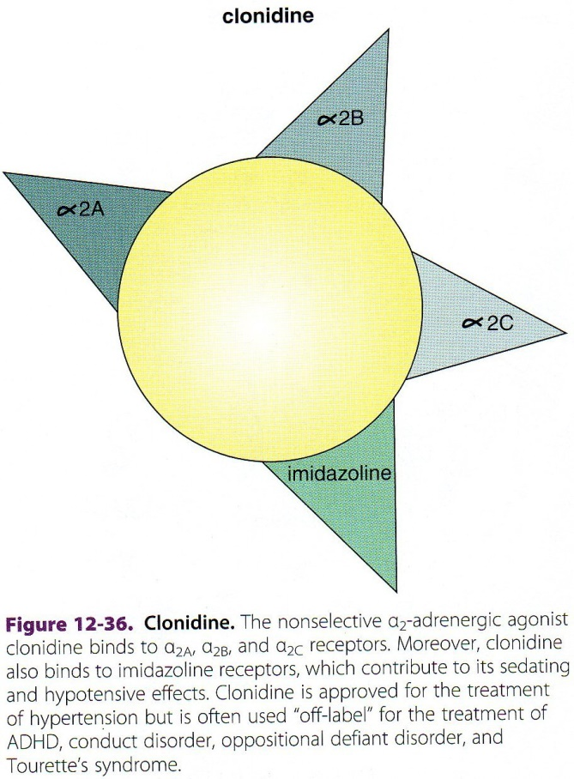
Insights from Natural History
The dramatic effects of psychedelics come from everything but 5-HT_{1/2}
5-HT₂ is antipsychedelic because it closes the gates of consciousness
Stahl, S. M. (2013). Stahl's Essential Psychopharmacology: Neuroscientific
Basis and Practical Applications. Cambridge University Press. P. 500

Slide 112
Insights from Natural History
The dramatic effects of psychedelics come from everything but 5-HT_{1/2}
5-HT₂ is psychedelic because it holds other mental organs in consciousness
5-HT₂

Slide 113

Hands of the Mind – Serotonin-2
drawing by
Pranab Das
Hindu Goddess Durga

Slide 114



Gatekeeper to Consciousness
Sensation
Closed
Affectively and
Cognitively Distant
High
Tranquil/Serene/Solid
Insight/Introspection
“Normal”
Serotonin-2
Caught-up in
Thoughts and Feelings
Overwhelmed by Thoughts
Feelings, Perceptions
Low
Under Assault by Thoughts
Feelings and Perceptions
Consciousness

Slide 115


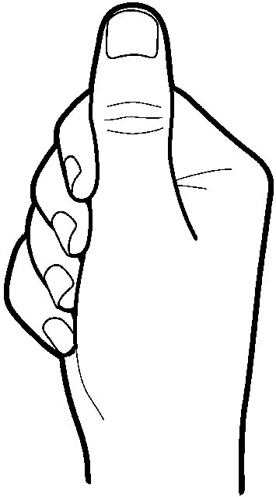
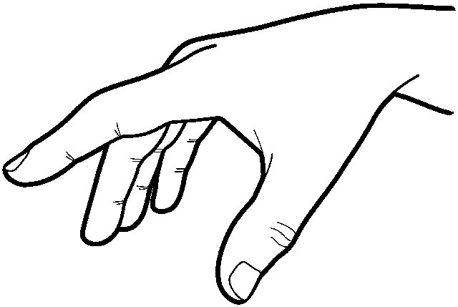
Hands of the Mind – Serotonin-2

Slide 116
MDMA Therapeutic Mechanism

Slide 117

MDMA Therapeutic Mechanism

Slide 118

MDMA Therapeutic Mechanism

Slide 119
MDMA Therapeutic Mechanism
I

Slide 120
Hypotheses from Natural History
In order for a content mental organ to enter consciousness, two things must happen:
  The content mental organ must be activated directly at its defining receptor
  The mental organ must be held in consciousness by simultaneous activation of serotonin-2, the hands of the mind
    There are other mental organs that can perform this function

Slide 121

Resting State

Slide 123
Rilmenidine – Blood Pressure Drug
I

Slide 124
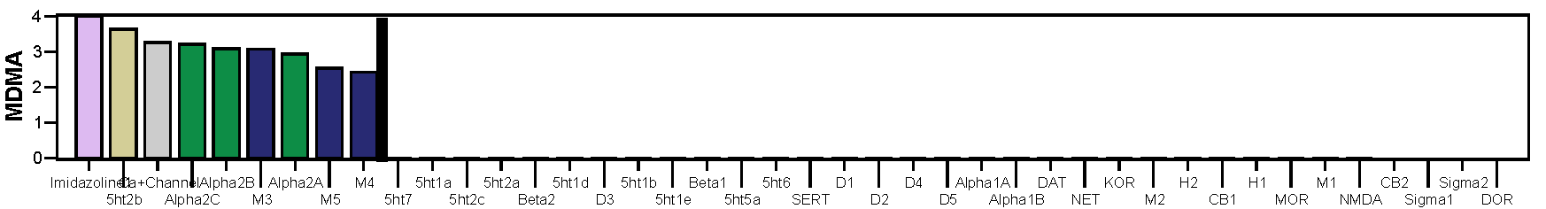
Ignore
I

Slide 125
& Rilmenidine
I

Slide 126
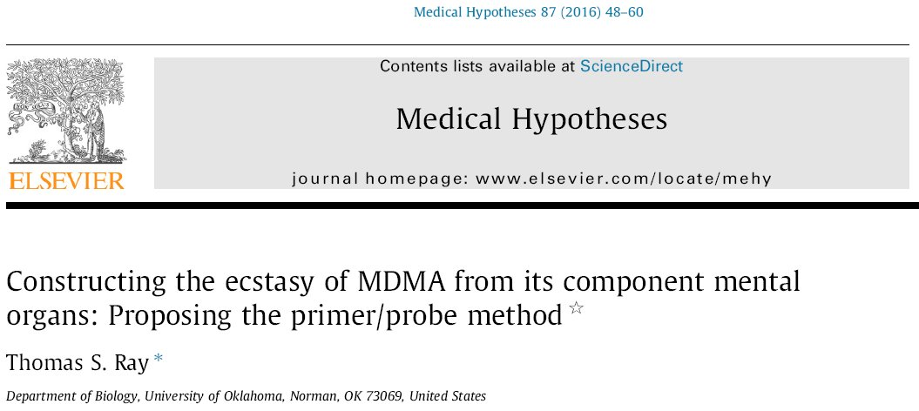
Hypotheses from Natural History

Slide 127
Primer/Probe Ecstasy
Imidazoline
8.0 mg 2C-B-fly and 2.0 mg of rilmenidine at 12:30 pm; cannabis vapor at 4:00: The result was spectacular. I got a +4 experience from a pure imidazoline blood pressure medication! It is probably the entactogenic core of MDMA.… I took cannabis vapor. Within minutes my heart opened and the rilmenidine fully blossomed… I was astonished by the depth of the experience, and I remained astonished for two weeks. … the mental state was ecstatic, somewhat un-sober. I recalled Martin Ball calling 5-MeO-DMT the “crown jewel of the entheogens”. I felt that rilmenidine must also be a crown jewel. I described the state with superlatives.…
Qualitatively, it is very hard to characterize the rilmenidine state, apart from the depth of it. At 3:52 hours she asked me how I feel, and I responded “It is like a peaceful lake, it feels eternal… in a peaceful sense”. Perhaps most telling, just 25 minutes after taking the cannabis, 3:55 hours after taking the rilmenidine, I spoke to my wife about what for me were the core issues in our relationship. These are things that are very hard to discuss because they are painful, and discussion tends to lead to anger. But we discussed it peacefully. I expressed my sadness with tears. I believe this capacity for calm contemplation and discussion of painful personal issues is a core feature of the entactogenic state of MDMA, and here I was experiencing it with blood pressure medication…. For me it’s really, astonishingly among the best psychedelic experiences I’ve ever had. Unbelievable.
(Shulgin 2016) Pharm 2, p. 26-27

Slide 128
Primers
5-HT_{1/2} Drugs with very subtle flavors

Slide 129
Probes
activate non-serotonin receptors
content mental organs
I – rilmenidine & moxonidine – blood pressure
α₁ – clonidine – blood pressure
D – ropinirole, pramipexole – Parkinson’s
β – clenbuterol – decongestant & bronchodilator
H₁ – betahistine – anti-vertigo
σ₁ – dimemorfan – cough suppressant
σ_{1/2} – ketamine – anesthetic

Slide 130

Probes
activate non-serotonin receptors
content mental organs
I – rilmenidine & moxonidine
α₁ – clonidine
D – ropinirole, pramipexole
β – clenbuterol
H₁ – betahistine
σ₁ – dimemorfan
σ_{1/2} – ketamine

Slide 131
Second Generation Psychedelics
Primer/Probe is adaptation of the ayahuasca principle
Combine multiple probes in varying proportions to confect the flavor of a drug with an ease and control that could never be achieved through synthetic chemistry

Slide 132
Second Generation Psychedelics
Proof of concept: 2nd generation Pharma Ecstasy
  No toxicity
  Reduced tendency to induce chronic tolerance
  Cleaner, more targeted receptor profile, reduced side-effects
  Different versions with different
    durations
    fine-tuned individualized qualitative entactogenic properties
Pharm Iboga

Slide 133
Breadth of Consciousness
The number and diversity of content mental organs held in consciousness
Shaped by serotonin-2 in interaction with content mental organs

Slide 134
Categories of Mental Organs
Many content mental organs – breadth
Mechanisms of consciousness
  Hands of the mind – shape breadth
  Mental space – depth

Slide 135
Categories of Mental Organs
Many content mental organs – breadth
Mechanisms of consciousness
  Hands of the mind – shape breadth
  Mental space – depth

Slide 136
Breadth & Depth
Consciousness expansion through
  Breadth (non-5-HT₂ held by 5-HT₂) provides a more complete and multifaceted experience of actual reality, that which actually exists; internally, externally, or socially.
  Depth (5-HT7) adds the spark of creativity, and allows us to go beyond actual reality, using our imagination, our creative capacity, to add to actual reality, to add novelty generated by our mind to that which actually exists. To consider not just what is, but also what could be.

Slide 137
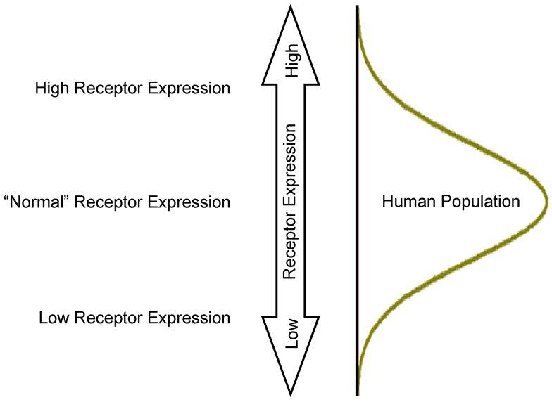
Receptor Spectrum

Slide 138
Depth
Depth (5-HT₇): “Won in youth to religion, she has cultivated my original qualities thus:—From the minute germ, natural affection, she has developed the overshadowing tree, philanthropy. From the wild stringy root of human uprightness, she has reared a due sense of the Divine justice. Of the ambition to win power and renown for my wretched self, she has formed the ambition to spread my Master’s kingdom; to achieve victories for the standard of the cross. So much has religion done for me; turning the original materials to the best account; pruning and training nature.” – The Parson St. John
Charlotte Brontë (1847) “Jane Eyre”

Slide 139
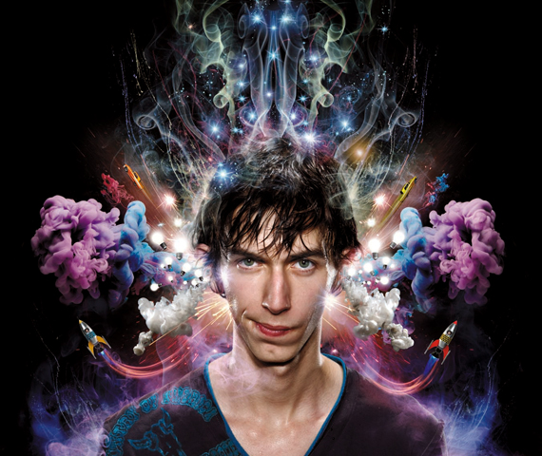
Depth
Serotonin-7 activation alters anything that enters consciousness
There seem to be common themes to its effects:
  Adds a creative exuberance
  Takes it to a higher level
  Makes connections
  Comprehends the bigger picture
  Creates sumptuousness, sparkle, grandeur, majesty, transcendence
  Intangible becomes tangible as if perceived through the senses
  Thoughts, feelings, motivations originating from within may be perceived to originate from without

Slide 140
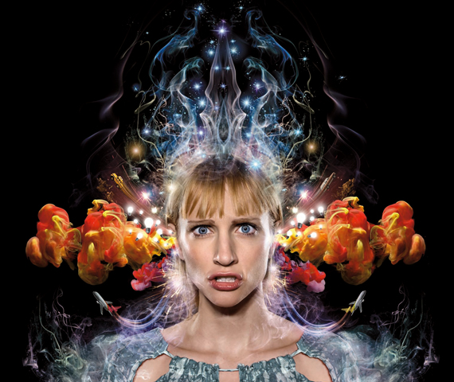
Depth
Anything held in consciousness becomes
  Rendered at “higher resolution”
    subtlety, nuance, complexity, tangibility, capacity, and vividness; of thought, feelings, and sensory input
Feels like genius
Lifts spirits
Sense of self can become thin or disappear

Slide 141
Depth
The sense of
  Something greater than one’s self
  Greater power
  God (with D)
  Cosmic

Slide 142
Depth
“You Are One”
by
“The Peaking Goddess Collective”
A generally positive.
It’s not just flowers and birdsong.
God is an earthquake as well.
It’s awesome, it’s terrifying.
You are one with the same force that provides the spiral arms of the galaxy.
That universal creativity is also what you are as well.
And when the mystic eye is open, and sees that,
a person is forever changed – Alex Grey

Slide 143
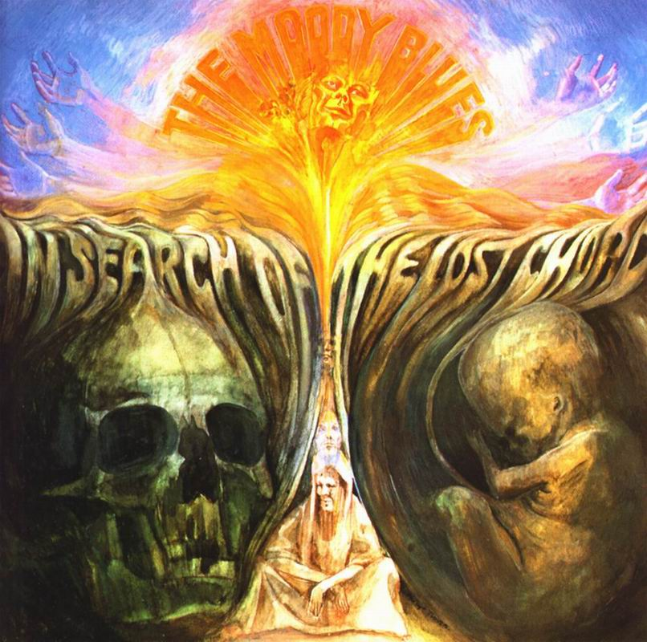
Depth
Autonomy
  Creation of
    Alternate worlds
    Entities
  Non-volitional
    Movements
    Vocalizations
  Knowledge
  Power
  Mind exists
    Independent of body
    Before or after body
    Transcend the cycle of birth & death
1968

Slide 144
5-HT₇ Mediates
open-eyed creative Visuals
Ego-loss
loss of contact with Reality
VER
open-eyed creative Visuals, Ego-loss, and/or loss of contact with Reality

Slide 145
Loss of Contact with Reality
high 5-HT₇

Slide 146


Depth
When the creative productions of the Serotonin-7 system become more salient than actual reality
  Pass through a mental event horizon
    Beyond the veil (Strassman)
  Discontinuity in mental space and time
  Mental cornucopia
    Mental big bang – creating worlds, universes
Camille Flammarion, L'Atmosphere: Météorologie Populaire (Paris, 1888)

Slide 147
Pharmacology
Pathology
Alternate Reality
High
Hallucination
Schizophrenia
Derealization
“Event Horizon”
“The Veil”
Tangibility
Creative, Genius
Imagination, Visualization
Fantasy, Vivid Memories
Planning, Creativity
5-HT₇ Expression
Healthy
Lack of Imagination
Mental Retardation
low intellectual & adaptive function
No Consciousness?
Low
pZombie?

Slide 148
Ego-loss
high 5-HT₇ & low 5-HT₂

Slide 149
Ego-loss Drugs
LSD, psilocin, 5-MeO-DMT
high 5-HT₇ & low 5-HT₂
can be achieved two ways
High affinity for 5-HT₇ with
  Low affinity for 5-HT₂: 5-MeO-DMT
  Low activation of 5-HT₂: LSD & psilocin

Slide 150
Ego-loss Drugs
LSD, psilocin
Most psychedelic’s activation of 5-HT₂ is ~100%
LSD’s activation of 5-HT₂ is 0-25% that of serotonin
Psilocin also low (~24-51% that of serotonin):

Slide 153

Resting State
5HT₂

Slide 154

moderate
dose
5HT₂

Slide 155
this is god
I am god
all is god
D
high
dose
5HT₂

Slide 156

5HT₂

Slide 157
moderate
dose
5HT₂

Slide 158

Ego Loss
The egoic sense of self emerges from the act of serotonin-2 shaping serotonin-7
When serotonin-7 is too strong for serotonin-2
  We can experience ego loss
    The dissolution of the sense of self, and the feeling of merging with our surroundings, or with the universe.
    We can feel as a drop in the ocean.
balance matters

Slide 159

Consciousness
an expansion of consciousness, by a blooming, through meditative practices, of the serotonin-7 mental organ of adult consciousness
Siddhartha Gautama (Buddha)
563 BCE to 483 BCE
Serotonin-7

Slide 160
Open-eyed Creative Visuals
requires both breadth & depth

Slide 161
Open-eyed Creative Visuals
2C-E 20 mg: “When I lay on my bed, I saw myself as an old, old man, many years in the future. I was appalled to see my forearm as a withered, dry-skinned, almost-bone which could only be that of someone dying. I looked down at the rest of me, and I was thin, emaciated, brittle, shallow.” (Shulgin & Shulgin 1991) p. 94-95

Slide 162
Open-eyed Creative Visuals
LSD 225 µg: subject on the street in Greenwich Village, NYC: “People continued to stream towards us and past us. I focused on an old lady in her late seventies, a dowdy pathetic creature dressed in shabby black and carrying impossibly huge shopping bags. As she made her way heavily towards us I saw, no longer much to my astonishment, that she began to lose years. I saw her as an Italian matriarch in her sixties, then in her fifties. As she continued to bloom backwards in time, she entered her portly forties and, after that, her housewifely thirties. Her face softened, her body grew more shapely, and still the years kept on dropping away. In her twenties she was carrying a child, and then she was a bride and carried orange blossoms. A moment later and she was a child who, in turn, shrank into a newborn baby carried by a midwife. The baby’s umbilical cord was still intact and it let out a howl of awakening life. But then the process was reversed and the baby grew back into childhood, became again a bride, passed through her thirties, forties, fifties, sixties, and was the old lady in her seventies I had seen at the beginning. The old woman blinked, her eyes closed for a fraction of a second, and in that instant I clearly saw her death mask. She passed us by and had moved a little down the street when I heard from the direction she had come a baby’s howl of awakening life. I turned my head, expecting to perceive afresh Our Lady of the Eternal Return, but saw instead the vortex of a crowd.” (Masters & Houston 1966) p. 23

Slide 163
Open-eyed Creative Visuals
DMT: “… an infinite hive. There were insectlike intelligences everywhere, in a hypertechnological space. I felt wet stuff hitting me all over my body. They were dripping stuff on me. They wanted me to join them, to stay with them. I was tempted. I was looking down a corridor that was stretching out forever. I lost awareness for a moment, then I found myself in that hive. There was another one helping me—different from the previous helper. It was very intelligent. It wasn’t at all humanoid. It wasn’t a bee, but it seemed like one. It was showing me around the hive. It was extremely friendly and I felt a warm, sensual energy radiating throughout the hive. It said to me [that] this was where our future lay.”
(Strassman et al. 2008) pp. 70

Slide 165
Resting State
5HT₂

Slide 166
D
alternate reality
α
5HT₂
H
I
σ
5-HT₁

Slide 167
formless void
5HT₂

Slide 168
VER = open-eyed creative Visuals, Ego-loss, or loss of contact with Reality
no VER values between .35 and .65
24 & 19 blind raters, 250 reports, 22 drugs
blind rating suggested by Matthew Baggott

Slide 169


Free Will
Serotonin-7 provides the spark of creativity
Serotonin-2 shapes that creativity, giving it form
  Free will emerges from this dynamic

Slide 170
The Human Mind
Is Not Healthy
Hard Ego
power; prestige; possession; control; acquisition; ambition; competition; superiority; fame; praise; recognition; admiration; notice; other’s attention; long hard work; playing social role; being right, special; whatever you can get away with; psychopathy…
(the list goes on)
Unhealthy Behavior
war, industrial war, nuclear war, genocide, slavery, colonialism, rape, mass rape, gang rape, child rape, murder, mass murder, serial murder, terrorism, torture, pillage, subjugation of women, polygamy, homophobia, unequal opportunity, unequal justice… (the list goes on)

Slide 171
Loss of Affect

Slide 172
Cognitive & Affective
Affective
cognitive & affective
reason & feeling
head & heart
modern & archaic
adult & child
human & animal
Affective
Cognitive
Our minds shift from affective to cognitive
  As we evolve from animals into modern humans
  As we grow from infants into adults

Slide 173
The ADHD Mathematician Alumnus a story within a story

Slide 174
3 Evolutionary Tiers of the Mind
Modern adult cognition
  language, logic, reason
Affect
  beauty, home, elegance, majesty, adventure, hope, joy, sublime…
Primal emotions
  anger/rage, fear, sadness, surprise, and disgust

Slide 175
3 Evolutionary Tiers of the Mind
Modern adult cognition
  language, logic, reason
Affect
  beauty, home, elegance, majesty, adventure, hope, joy, sublime…
Primal emotions
  anger/rage, fear, sadness, surprise, and disgust

Slide 176

Loss of Affect
2014
http://www.imdb.com/title/tt2084970/

Slide 177


Slide 178
Loss of Affect
The hows and whys of the action of this fascinating family of compounds is still a mystery, but some unorthodox speculations are tempting. Our cultural heritage requires the initial conclusion that these transient yet potentially enduring changes of states of consciousness are unnatural or abnormal. But perhaps they reveal the “normal” state through some disinhibition of an evolutionarily imposed safeguard. Perhaps these chemicals, by themselves, or through the in vivo conversion to some intrinsically appropriate metabolite, may serve a neurotransmitter role at some synaptic network, restoring certain neurological functions that have been lost through evolution. To many people, the states of awareness that are experienced are not “abnormal,” but rather, familiar territory that had been lost in some primal amnesia.
Shulgin, A. T. 1983. Twenty years on an ever-changing quest. In: Lester Grinspoon, James B. Bakalar [eds.], "Psychedelic Reflections", Human Sciences Press, Inc., New York. Pp. 205-212.

Slide 179


Cultural Environment
Innate Psychology
100,000 generations

Slide 180

Cultural Environment
Innate Psychology

Slide 181

Cultural Environment
Innate Psychology

Slide 182
Cultural Environment
Innate Psychology

Slide 183

Cultural Environment
Innate Psychology

Slide 184


Cultural Environment
Innate Psychology

Slide 185

Cultural Environment
Innate Psychology

Slide 186

Cultural Environment
Innate Psychology

Slide 187

Cultural Environment
Innate Psychology

Slide 188

Disease of Civilization
the number of insane persons per 1000 population increased from approximately 0.5 per 1,000 in 1850 to 3.2 per 1,000 in 1950, a six fold increase. The largest percentage of these insane individuals had the disease we now call schizophrenia.
E. Fuller Torrey, MD
Treatment Advocacy Center founder
Anatomy of a Non-Epidemic
Critique of Whitaker
http://www.treatmentadvocacycenter.org/index.php?option=com_content&task=view&id=2085

Slide 189

Disease of Civilization
In reviewing the rise of insanity, one of the most striking aspects is its temporal correlation with the industrial revolution. This revolution began in England in the 1760s… England was gradually transformed from a village-centered, agrarian society to an urban-centered, industrial society. The industrial revolution spread throughout England, to other parts of Europe, including Ireland, and later to the United States and Canada. The rise of insanity in the nineteenth century closely paralleled the rise of the urban, industrialized society. p. 328

Slide 190
Hard Ego
power; prestige; possession; control; acquisition; ambition; competition; superiority; long hard work; playing social role; being right, special; having fame, praise, recognition, admiration, notice, other’s attention; whatever you can get away with; psychopathy…
(the list goes on)
Unhealthy Behavior
war, industrial war, nuclear war, genocide, slavery, colonialism, rape, mass rape, gang rape, child rape, murder, mass murder, serial murder, terrorism, torture, pillage, subjugation of women, polygamy, homophobia, unequal opportunity, unequal justice…
(the list goes on)

Slide 191
Hard Ego Problem/Solution
Hard Ego
Ego-loss

Slide 192
Hard Ego Problem/Solution
Middle Way
Soft Ego
Hard Ego
Ego-loss

Slide 193
Hard Ego Problem/Solution
Middle Way
Soft Ego
Hard Ego
Ego-loss
bringing any one or more
affective mental organs
into consciousness

Slide 194
Hard Ego Problem/Solution
can’t live here
Middle Way
Soft Ego
Hard Ego
Ego-loss
bringing any one or more
affective mental organs
into consciousness

Slide 195
Alpha-1
0.2 mg clonidine and 9.0 mg of 2C-B-fly at noon, cannabis at 3:00 pm:
I found that this state is what makes life worth living. This is what I want out of life. I was not incapacitated in any way, and felt that I could go through life in this state, and would be better for it... I felt that I recognized a sensibility of continuity in my thoughts, e.g. thinking about the changes we go through as we mature from childhood through adolescence into adulthood. I observed: “I believe that I feel a sense of continuity, in that I exist in the moment, and in the time around it. I occupy a greater temporal breadth. This provides a great connection.” I was very present, but not just in the moment.
(Shulgin 2016) Pharm 2, p. 25
Primer/Probe clonidine

Slide 196
The Middle Way
Hard Ego
Modern adult cognition
  language, logic, reason
Affect
  beauty, home, elegance, majesty, adventure, hope, joy, sublime…
Primal emotions
  anger/rage, fear, sadness, surprise, and disgust

Slide 197
The Middle Way
Soft Ego
Modern adult cognition
  language, logic, reason
Affect
  beauty, home, elegance, majesty, adventure, hope, joy, sublime…
Primal emotions
  anger/rage, fear, sadness, surprise, and disgust

Slide 198
The Middle Way – Hard Ego
When you don’t cover up the world with words and labels, a sense of the miraculous returns to your life that was lost a long time ago when humanity, instead of using thought, became possessed by thought. A depth returns to your life. Things regain their newness, their freshness. And the greatest miracle is the experiencing of your essential self as prior to any words, thoughts, mental labels, and images. For this to happen, you need to disentangle your sense of I, of Beingness, from all the things it has become mixed up with, that is to say, identified with... The quicker you are in attaching verbal or mental labels to things, people, or situations, the more shallow and lifeless your reality becomes, and the more deadened you become to reality, the miracle of life that continuously unfolds within and around you. In this way, cleverness may be gained, but wisdom is lost, and so are joy, love, creativity, and aliveness. Eckhart Tolle, “A New Earth” pp. 26-27.

Slide 199
The Middle Way – Soft Ego
When you don’t cover up the world with words and labels, a sense of the miraculous returns to your life that was lost a long time ago when humanity, instead of using thought, became possessed by thought. A depth returns to your life. Things regain their newness, their freshness. And the greatest miracle is the experiencing of your essential self as prior to any words, thoughts, mental labels, and images. For this to happen, you need to disentangle your sense of I, of Beingness, from all the things it has become mixed up with, that is to say, identified with... The quicker you are in attaching verbal or mental labels to things, people, or situations, the more shallow and lifeless your reality becomes, and the more deadened you become to reality, the miracle of life that continuously unfolds within and around you. In this way, cleverness may be gained, but wisdom is lost, and so are joy, love, creativity, and aliveness. Eckhart Tolle, “A New Earth” pp. 26-27.

Slide 200




Collapse of Breadth

Slide 201
Lao-Tzu (Tao):
Beta & Alpha-2
Shinto: Alpha-2
Confucius: Beta
Jesus:
Imidazoline & Dopamine
Patanjali (Yoga): Sigma
Siddhartha Gautama:
Serotonin-7
Socrates: Serotonin-1

Slide 202

Lao-Tzu (Tao):
Beta & Alpha-2
Shinto: Alpha-2
Confucius: Beta
Jesus:
Imidazoline & Dopamine
Patanjali (Yoga): Sigma
Siddhartha Gautama:
Serotonin-7
Socrates: Serotonin-1

Slide 203
Reading a Dictionary
When I open a dictionary and read through words, it is never a silent, static experience. Every word is robust with its meaning and sound, and oftentimes I would mentally provide a context to give the word an extra layer of personal feeling...
I was at the word “abalone”... my imagery about abalone at that moment was a happy one: At a family feast, we ordered steamed abalone; each helping was filled individually in a small white china saucer; the waitresses filed in each carrying a lacquer tray with four individual helpings of abalone in it; the way it was presented to us and the tiny portion made me feel it was an expensive dish (it certainly was)...
I would feel the rumbling sound of a tire rolling on an asphalt road in the word “road”. In the word “abject” I would sense the sorrow, a perilous state a person might be in, his facial expression, his skin tone, his possible gestures, and gaits...
I remember the word “sandalwood”. I liked it at the moment I saw it, and it actually invoked a mood associated with an imagined story so I wrote a poem with it...
If it’s a rainy day, I might be able to simultaneously feel the moisture of the air and its grassy and earthy smell while turning leaves of my dictionary; and if I peruse my dictionary at the sunset, I would feel the dancing quality of the sun rays. It is very relaxing and easy.

Slide 204
Integration of Cognitive & Affective
When I open a dictionary and read through words, it is never a silent, static experience. Every word is robust with its meaning and sound, and oftentimes I would mentally provide a context to give the word an extra layer of personal feeling...
I was at the word “abalone”... my imagery about abalone at that moment was a happy one: At a family feast, we ordered steamed abalone; each helping was filled individually in a small white china saucer; the waitresses filed in each carrying a lacquer tray with four individual helpings of abalone in it; the way it was presented to us and the tiny portion made me feel it was an expensive dish (it certainly was)...
I would feel the rumbling sound of a tire rolling on an asphalt road in the word “road”. In the word “abject” I would sense the sorrow, a perilous state a person might be in, his facial expression, his skin tone, his possible gestures, and gaits...
I remember the word “sandalwood”. I liked it at the moment I saw it, and it actually invoked a mood associated with an imagined story so I wrote a poem with it...
If it’s a rainy day, I might be able to simultaneously feel the moisture of the air and its grassy and earthy smell while turning leaves of my dictionary; and if I peruse my dictionary at the sunset, I would feel the dancing quality of the sun rays. It is very relaxing and easy.

Slide 205

Tom Ray
Chenmei Xu
Feb 12, 2015

Slide 206
How can we restore breadth of consciousness?
momentarily
long-term

Slide 207
Change Culture

Slide 208
Change Mind

Slide 209


Slide 210
Student Question
“Dr. Ray, is there a drug that
activates the full bouquet?”

Slide 211
Follow-up Question
“What is it like?”

Slide 212

DMT ~ Full Bouquet: Fully Human /Veil/ Fully Alien
Patricio Dominguez (DMT volunteer, shaman) “This meteor-like trip through, through the infinite space of the interior consciousness is, up pops the picture puzzle pattern door. And I’m now whizzing through this sucker like if it was nothing, it just, I’m flying through it. But now I know what the picture puzzle pattern door is. The picture puzzle pattern door is the farthest reaches of your humanity. This is the doorway into… what defines you as a human being. When you go past that, you stop being human, to a degree, and the further you get past this point, the further away you go from being a human being. But right here this… door is everything. It’s everything, it’s what defines you as a human being. This is... you.” 0:39:12 Schultz, M. (2010). DMT: The Spirit Molecule
Patricio Dominguez

Slide 213

DMT ~ Full Bouquet: Fully Human /Veil/ Fully Alien
Taking a substance like ayahuasca is like looking into the clearest mirror imaginable where you will gain a new perspective on life, and see what you have never seen before, how you really are.
YouTube (2012). Tierra Vida - An Ayahuasca Journey. Available via http://www.youtube.com/watch?v=PKiVRwppgAc
Alexander Ward

Slide 214

DMT ~ Full Bouquet: Fully Human /Veil/ Fully Alien
Ayahuasca users whom UCLA’s Grob has researched in other countries:
“have become better partners to their spouses, better parents to their children, better children to their parents, better employees, better employers, just more responsible overall, bringing a higher level of ethical integrity to everything they do,” – Grob
McClelland, M. (2017, March 9). How some doctors are risking everything to unleash the healing power of MDMA, ayahuasca and other hallucinogens. Available via http://www.rollingstone.com/culture/features/how-doctors-treat-mental-illness-with-psychedelic-drugs-w470673
This ethical integrity likely emerges from reintegration with sigma, the “plant teacher”
Charles Grob

Slide 215
DMT ~ Full Bouquet
D
α
5HT₂
H
5HT₇
I
σ
5HT₁

Slide 216
Cannabis ~ Full Bouquet
D
5HT₂
α
H
5HT₇
I
5HT₁
σ

Slide 217
Many Paths Away From Hard Ego
- Bwiti
- Mazatec -
-
- Rastafarian
League for
Spiritual
Discovery
- Native American Church
- MAPS
- Temple of Awakening Divinity
Inner
Pantheon
- Santo Daime, União do Vegetal
- Temple of the True Inner Light

Slide 218






Slide 219
For those who embrace the 5-HT₂ paradigm, in its simplicity, I hope that I have created some doubt that it is a productive way of looking at the psychedelic process

Slide 220

I believe that the greatest scientific value of Sasha’s work is that he created a diverse toolkit of probes into the human mind, that allow the unlocking of many of its secrets.
Tom Ray & Sasha Shulgin 1993

Slide 221

Sasha has provided us with a methodology for mental discovery. I don’t believe that there is any other method that can make as deep a penetration into the structure, function, process, genetics, development, and evolution of the human mind, and mechanisms of consciousness.
Tom Ray & Sasha Shulgin 2003

Slide 222

We can put this knowledge to work not just in providing new approaches to understanding the etiology, diagnosing, treating, and healing mental disorders; but also in understanding ourselves. We owe these discoveries to the foundations that Sasha has laid.
Tom Ray & Sasha Shulgin 2011

Slide 223
Supported By
Advanced Telecommunications Research Institute International –
Human Information Science Laboratories
National Institute of Mental Health –
Psychoactive Drug Screening Program
National Institute on Drug Abuse –
Drug Supply Program
Shulgin Archive

Slide 224
Contact
tomray000@gmail.com
http://life.ou.edu/

Slide 225
Video, PowerPoint & Manuscript
This video and associated PowerPoint
and manuscript are available at:
www.transformpress.com/breadth-and-depth
Transform Press
PO Box 11552
Berkeley, CA 94712
transformpress@gmail.com
www.transformpress.com/
twitter.com/transformpress
www.facebook.com/transformpress

Slide 226
The End
A new scientific truth does not triumph by convincing its opponents and making them see the light, but rather because its opponents eventually die, and a new generation grows up that is familiar with it.
– Max Planck, 1906

